Slide 1

Intermediate Code Genarator

Slide 2
All Types of Errors( During Compiling to execution)
Compiling Error : rises at compile time, before execution of the program. Syntax error or missing file reference that prevents the program from successfully compiling is the example of this.
Lexical : This includes misspellings of identifiers, keywords or operators
Syntactical : missing semicolon or unbalanced parenthesis
Semantical : incompatible value assignment or type mismatches between operator and operand
Runtime Error: Is an error which takes place during the execution of a program, and usually happens because of adverse system parameters or invalid input data. The lack of sufficient memory to run an application or a memory conflict with another program and logical error are example of this.
Logical Error: Logic errors, occur when executed code does not produce the expected result. Logic errors are best handled by meticulous program debugging. code not reachable, infinite loop.

Slide 3
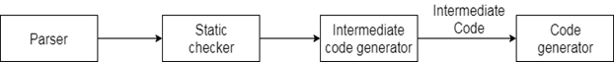
What is IR / ICG?
Intermediate code/ Intermediate representation is used to translate the source code into the machine code. Intermediate code lies between the high-level language and the machine language.

Slide 4
IR
Front End
Back End
Machine Code
Errors

Slide 5
Why We Need IR / ICG?

Slide 6
01
02
04
03
If the compiler directly translates source code into the machine code without generating intermediate code then a full native compiler is required for each new machine.
The intermediate code keeps the analysis portion same for all the compilers that's why it doesn't need a full compiler for every unique machine.
Using the intermediate code, the second phase of the compiler synthesis phase is changed according to the target machine.
It becomes easier to apply the source code modifications to improve code performance by applying code optimization techniques on the intermediate code.

Slide 7
Intermediate codes can be represented in a variety of ways and they have their own benefits.
High Level IR - High-level intermediate code representation is very close to the source language itself. They can be easily generated from the source code and we can easily apply code modifications to enhance performance. But for target machine optimization, it is less preferred.
Low Level IR - This one is close to the target machine, which makes it suitable for register and memory allocation, instruction set selection, etc. It is good for machine-dependent optimizations.
Intermediate code can be either language specific (e.g., Byte Code for Java) or language independent (three-address code).

Slide 8
Some Techniques of ICG/IR
Intermediate code generator receives input from its predecessor phase, semantic analyzer, in the form of an annotated syntax tree. That syntax tree then can be converted into a linear representation, e.g., postfix notation. Intermediate code tends to be machine independent code. Therefore, code generator assumes to have unlimited number of memory storage (register) to generate code.
Three Address Code
DAG (Direct Acyclic Graph)
AST ( Abstract syntax tree)

Slide 9
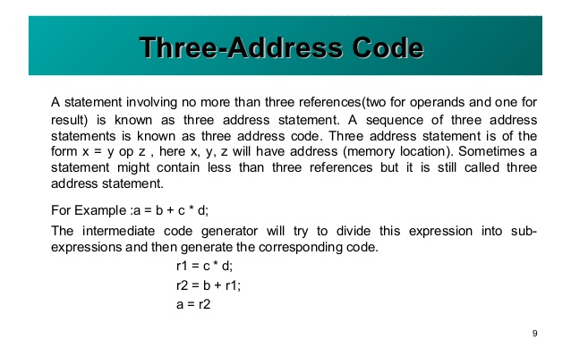
Three Address Code

Slide 10
Three Address Code
Three-address code is an intermediate code. It is used by the optimizing compilers.
In three-address code, the given expression is broken down into several separate instructions. These instructions can easily translate into assembly language.
Each Three address code instruction has at most three operands. It is a combination of assignment and a binary operator.
Given Expression:
a := (-c * b) + (-c * d)
Three-address code is as follows:
t1 := -c
t2 := b*t1
t3 := -c
t4 := d * t3
t5 := t2 + t4
a := t5
t is used as registers in the target program.

Slide 11

A three-address code can be represented in two forms : quadruples and triples.
Quadruples
Triples

Slide 12
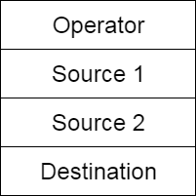
The quadruples have four fields to implement the three address code. The field of quadruples contains the name of the operator, the first source operand, the second source operand and the result respectively.
Quadruples
Fig: Quadruples field

Slide 13
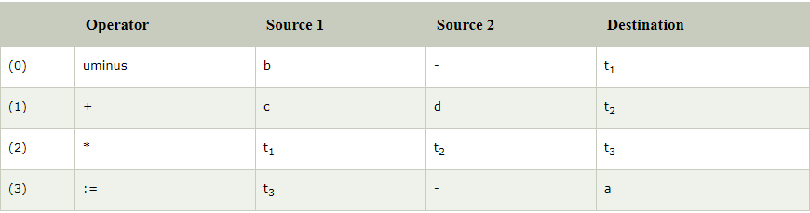
Example:
a := -b * c + d
Three-address code is as follows:
t₁ := -b
t₂ := c + d
t₃ := t₁ * t₂
a := t₃
These statements are represented by quadruples as follows:

Slide 14
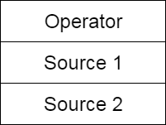
The triples have three fields to implement the three address code. The field of triples contains the name of the operator, the first source operand and the second source operand. In triples, the results of respective sub-expressions are denoted by the position of expression. Triple is equivalent to DAG while representing expressions.
Triples
Fig: Triples field

Slide 15
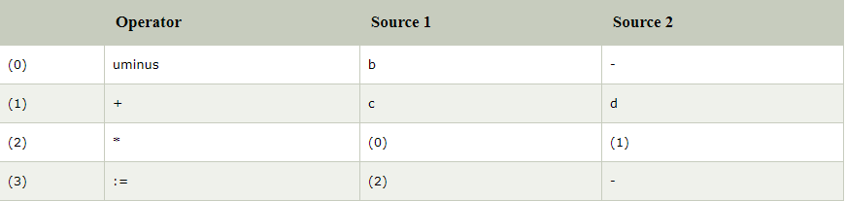
Example:
a := -b * c + d
Three-address code is as follows:
t₁ := -b
t₂ := c + d
t₃ := t₁ * t₂
a := t₃
These statements are represented by triples as follows:

Slide 16
Triples face the problem of code immovability while optimization, as the results are positional and changing the order or position of an expression may cause problems. Indirect Triples This representation is an enhancement over triples representation. It uses pointers instead of position to store results. This enables the optimizers to freely re-position the sub-expression to produce an optimized code.

Slide 17
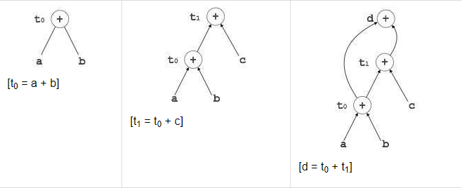
Directed Acyclic Graph(DAG) Directed Acyclic Graph (DAG) is a tool that depicts the structure of basic blocks, helps to see the flow of values flowing among the basic blocks, and offers optimization too. DAG provides easy transformation on basic blocks. DAG can be understood here: Leaf nodes represent identifiers, names or constants. Interior nodes represent operators. Interior nodes also represent the results of expressions or the identifiers/name where the values are to be stored or assigned. Example: t₀ = a + b t₁ = t₀ + c d = t₀ + t₁

Slide 18
Applications:
DAGs are used for the following purposes-
To determine the expressions which have been computed more than once (called common sub-expressions).
To determine the names whose computation has been done outside the block but used inside the block.
To determine the statements of the block whose computed value can be made available outside the block.
To simplify the list of Quadruples by not executing the assignment instructions x:=y unless they are necessary and eliminating the common sub-expressions.
Following rules are used for the construction of DAGs-
Rule-01:
In a DAG,
Interior nodes always represent the operators.
Exterior nodes (leaf nodes) always represent the names, identifiers or constants.
Rule-02:
While constructing a DAG,
A check is made to find if there exists any node with the same value.
A new node is created only when there does not exist any node with the same value.
This action helps in detecting the common sub-expressions and avoiding the re-computation of the same.
Rule-03:
The assignment instructions of the form x:=y are not performed unless they are necessary

Slide 19
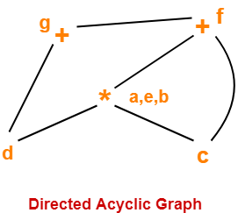
Consider the following block and construct a DAG for it-
(1)a = b x c
(2) d = b
(3) e = d x c
(4) b = e
(5) f = b + c
(6) g = f + d
Solution-
Directed Acyclic Graph for the given block is-

Slide 20
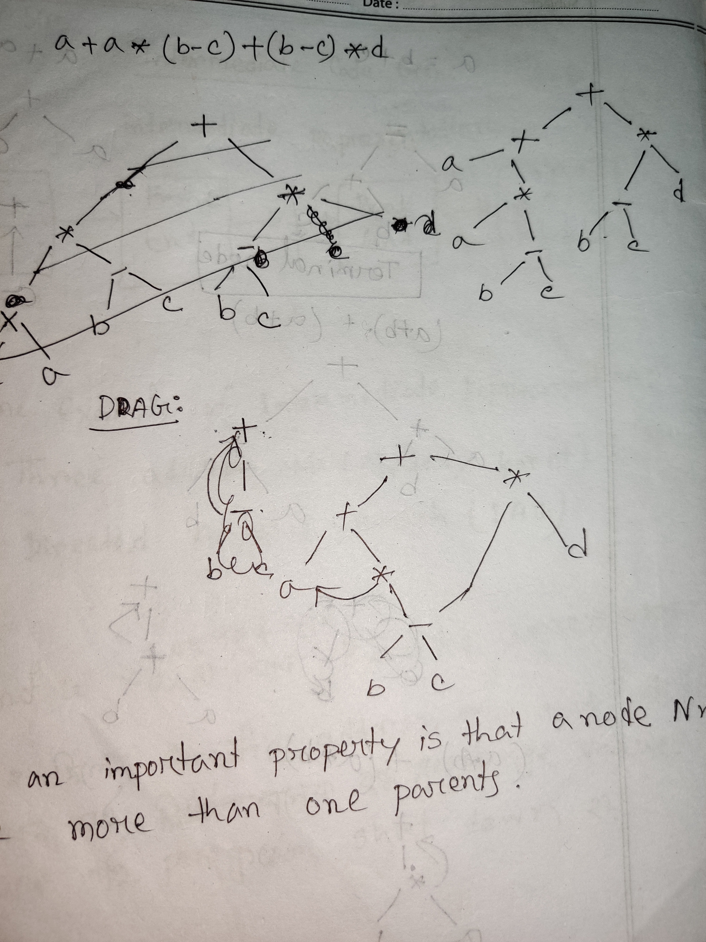

Slide 21
How to Implement DAG
0 | id | a
1 | id | b
2 | id | c
3 | - | (1)|(2)
4 | * | (0)|(3)
5 | + | (0)|(4)
6 | id | d
7 | * | (3)|(6)
8 | + | (5)|(7)
Value number method will be used to implement a DAG
*
Before creating a new node with (id, entry)search whether there exist such node.
If(node already present) return that node with proper pointing
else
Create new node and return.
Example:
a+a*(b-c)+(b-c)*d
+
*
d
a
*
-
b
c

Slide 22
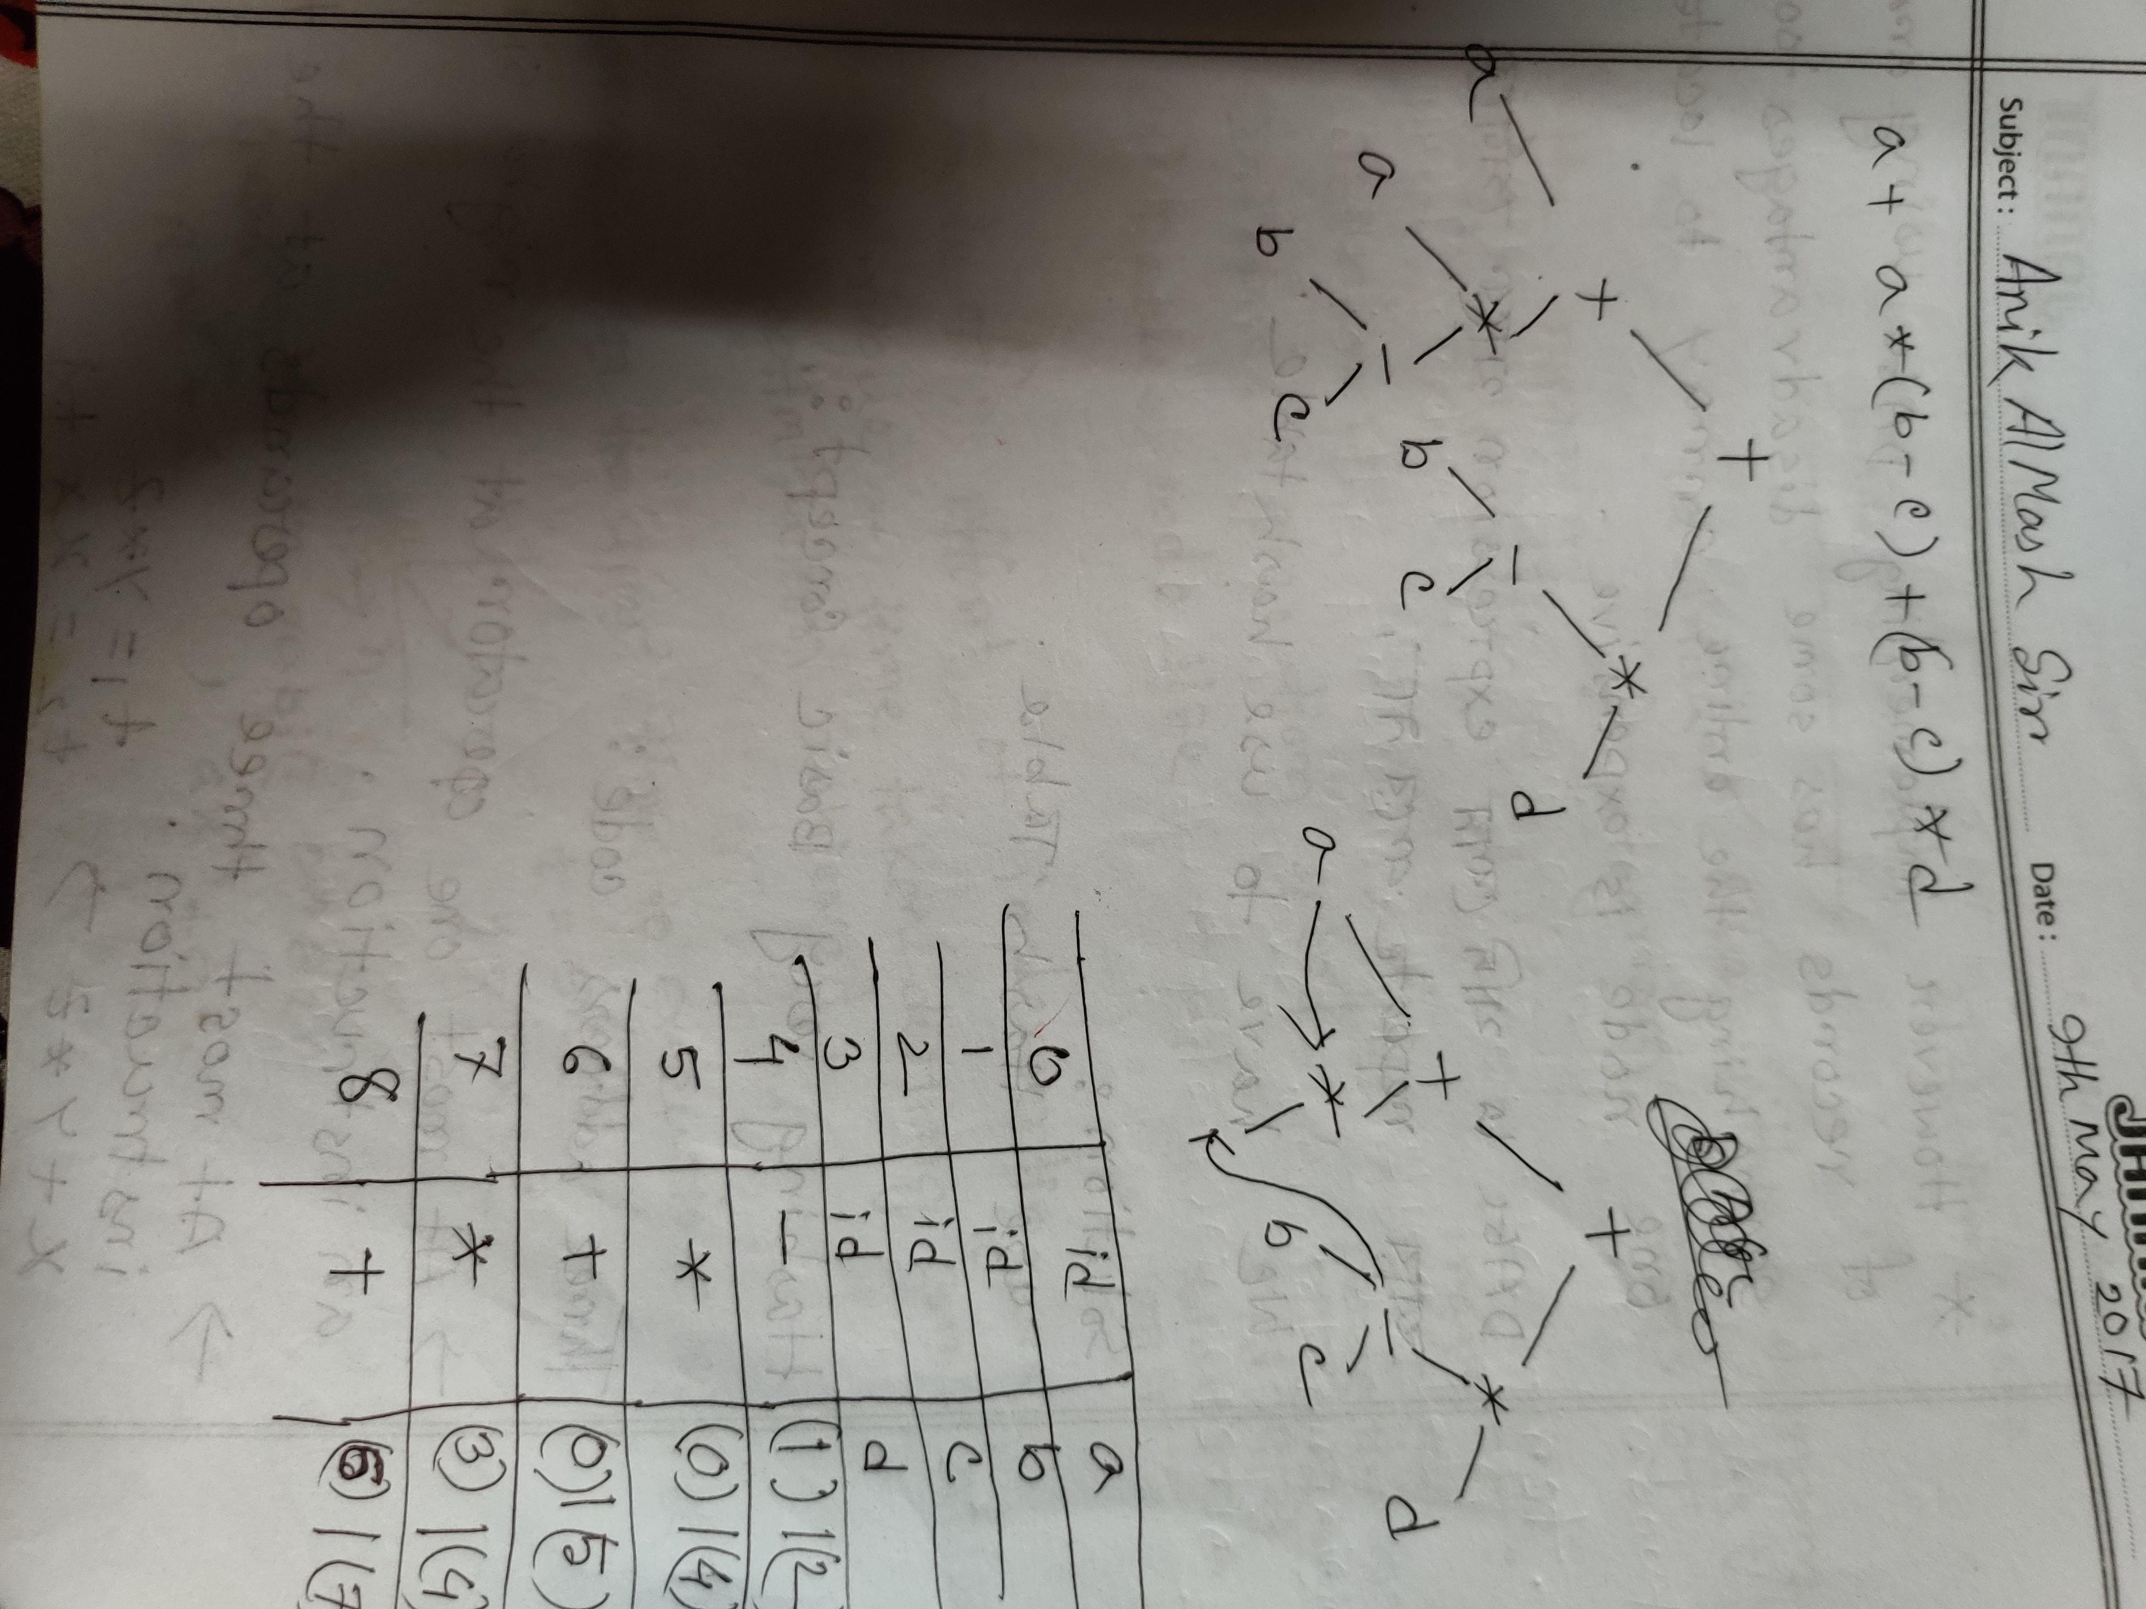

Slide 23
Problem With DAG

Slide 24
Solution
Hash Table

Slide 25
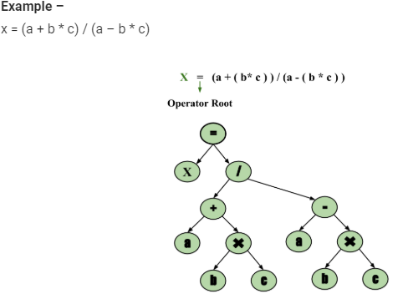
Syntax Tree –
Syntax tree is nothing more than condensed form of a parse tree. The operator and keyword nodes of the parse tree are moved to their parents and a chain of single productions is replaced by single link in syntax tree the internal nodes are operators and child nodes are operands. To form syntax tree put parentheses in the expression, this way it's easy to recognize which operand should come first.

Slide 26
Summary
Code generation can be considered as the final phase of compilation. Through post code generation, optimization process can be applied on the code, but that can be seen as a part of code generation phase itself. The code generated by the compiler is an object code of some lower-level programming language, for example, assembly language. We have seen that the source code written in a higher-level language is transformed into a lower-level language that results in a lower-level object code, which should have the following minimum properties:
It should carry the exact meaning of the source code.
It should be efficient in terms of CPU usage and memory management.
We will now see how the intermediate code is transformed into target object code (assembly code, in this case).

Slide 27
THANKS!
Do you have any questions?

